Slide 1

Wireless Network
By-
Dr. Jesmin Akhter
Professor
Institute of Information Technology
Jahangirnagar University

Slide 2
Contents
The course will mainly cover the following topics:
Wireless Networking
Multiple Access techniques for wireless Communications
Modulation Techniques for mobile radio
The Cellular Concepts

Slide 3
Outline
Modulation Techniques for mobile radio
Digital modulation techniques,
Spectral efficiency
Orthogonal Frequency Division Multiplexing

Slide 4
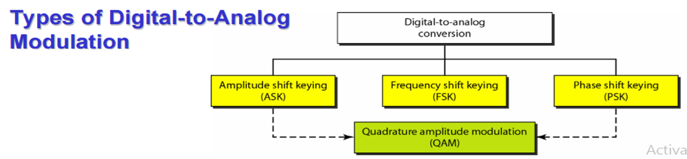
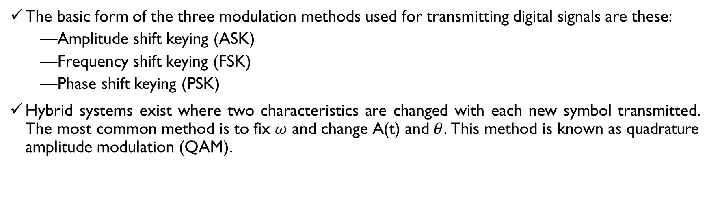
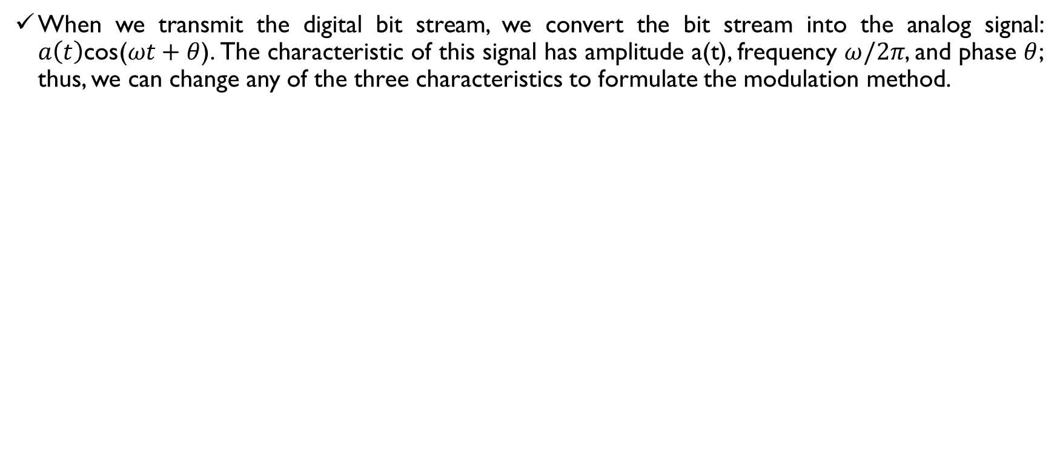
Introduction to Modulation
When we transmit the digital bit stream, we convert the bit stream into the analog signal: $a\left(t\right)\text{cos}$($ωt+θ$). The characteristic of this signal has amplitude a(t), frequency $ω/2π$, and phase $θ$; thus, we can change any of the three characteristics to formulate the modulation method.
The basic form of the three modulation methods used for transmitting digital signals are these:
Amplitude shift keying (ASK)
Frequency shift keying (FSK)
Phase shift keying (PSK)
Hybrid systems exist where two characteristics are changed with each new symbol transmitted. The most common method is to fix $ω$ and change A(t) and $θ$. This method is known as quadrature amplitude modulation (QAM).

Slide 5
Introduction to Modulation
Modulation is the process of varying one or more properties of a periodic waveform, called the carrier signal, with a modulating signal that typically contains information to be transmitted.
Digital to analog Modulation The process of changing one of the characteristic of an analog signal (Typically a sinewave) based on the information in a digital signal
The main goal of modulation today is to squeeze as much data into the least amount of spectrum possible. That objective, known as spectral efficiency, measures how quickly data can be transmitted in an assigned bandwidth.

Slide 6
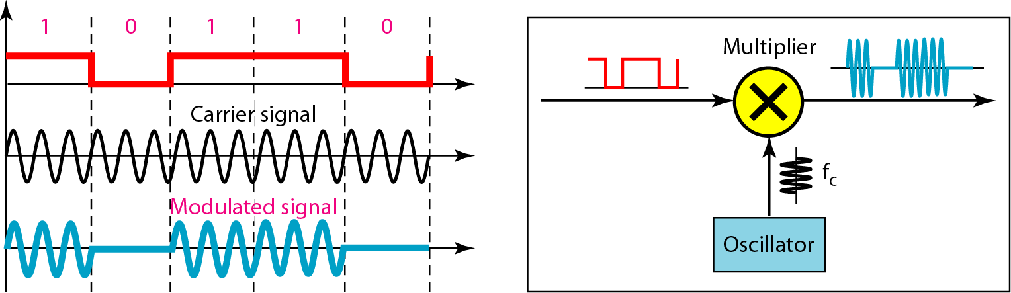
Amplitude Shift Keying (ASK)
ASK is implemented by changing the amplitude of a carrier signal to reflect amplitude levels in the digital signal.
For example: a digital “1” could not affect the signal, whereas a digital “0” would, by making it zero.
The line encoding will determine the values of the analog waveform to reflect the digital data being carried.
Figure Implementation of binary ASK

Slide 7
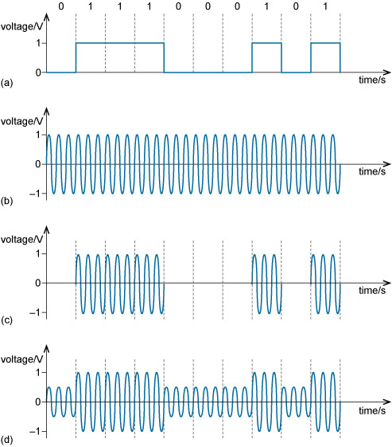
Amplitude Shift Keying (ASK)
In ASK, only the amplitude of the carrier signal is modified in modulation. The simplest version is on–off keying (OOK). In OOK, either bursts of a carrier wave are transmitted or nothing is transmitted depending whether the input message signal is 1 or 0. Other versions of ASK use differing (non-zero) amplitudes to represent 1 and 0.
Figure (a) shows a digital message signal using two voltage levels. One level represents 1 and the other represents 0. The unmodulated carrier is illustrated in Figure (b). Figure (c) and (d) are the modulated waveforms using two versions of ASK. Figure (c) uses OOK, and (d) uses binary ASK, or BASK.

Slide 8
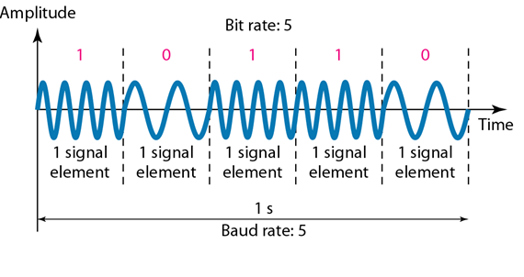
Frequency Shift Keying
The digital data stream changes the frequency of the carrier signal, f_{c}.
For example, a “1” could be represented by f₁=f_{c} +Δf, and a “0” could be represented by f₂=f_{c}-Δf.
Figure Binary frequency shift keying
Notes:
The term baud refers to the number of symbols per second, where one baud is one symbol per second. Data rate (or bit rate) and baud are closely related.

Slide 9
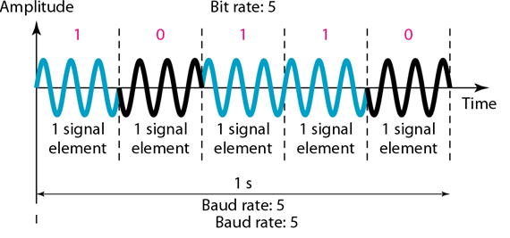
Phase Shift Keyeing
We vary the phase shift of the carrier signal to represent digital data.
PSK is much more robust than ASK as it is not that vulnerable to noise, which changes amplitude of the signal.
Figure Binary phase shift keying

Slide 10
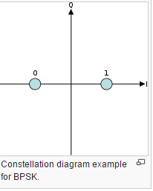
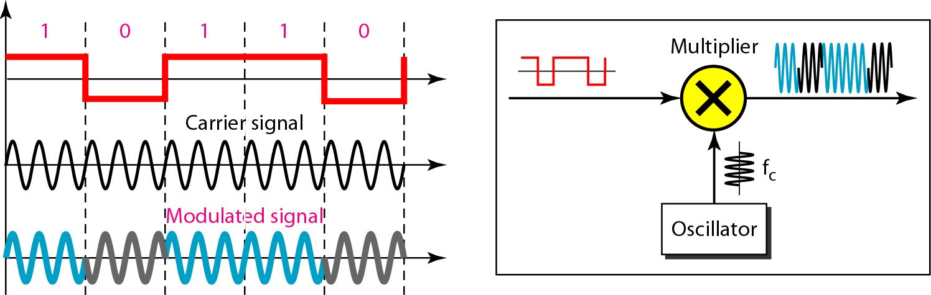
Binary Phase Shift Keyeing
Binary phase-shift keying BPSK is the simplest form of phase shift keying (PSK). It uses two phases which are separated by 180° . BPSK is able to transmit one bit per symbol. It only able to modulate at 1 bit/symbol and so is unsuitable for high data-rate applications.
Figure Implementation of BPSK

Slide 11
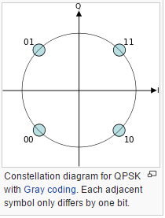
Quadrature PSK (QPSK) modulation
QPSK uses four points on the constellation diagram. Quadrature Phase Shift Keying QPSK transmits two bits per symbol. So QPSK can be used to double the data rate but still use the same bandwidth and have a bit error rate performance that is the same as that of the BPSK scheme.
Notes:
the state of the carrier is called a symbol, and it’s defined as having a specific phase, magnitude, and frequency. symbol rate is the pulse rate in pulses per second. Each symbol can represent or convey one or several bits of data.

Slide 12
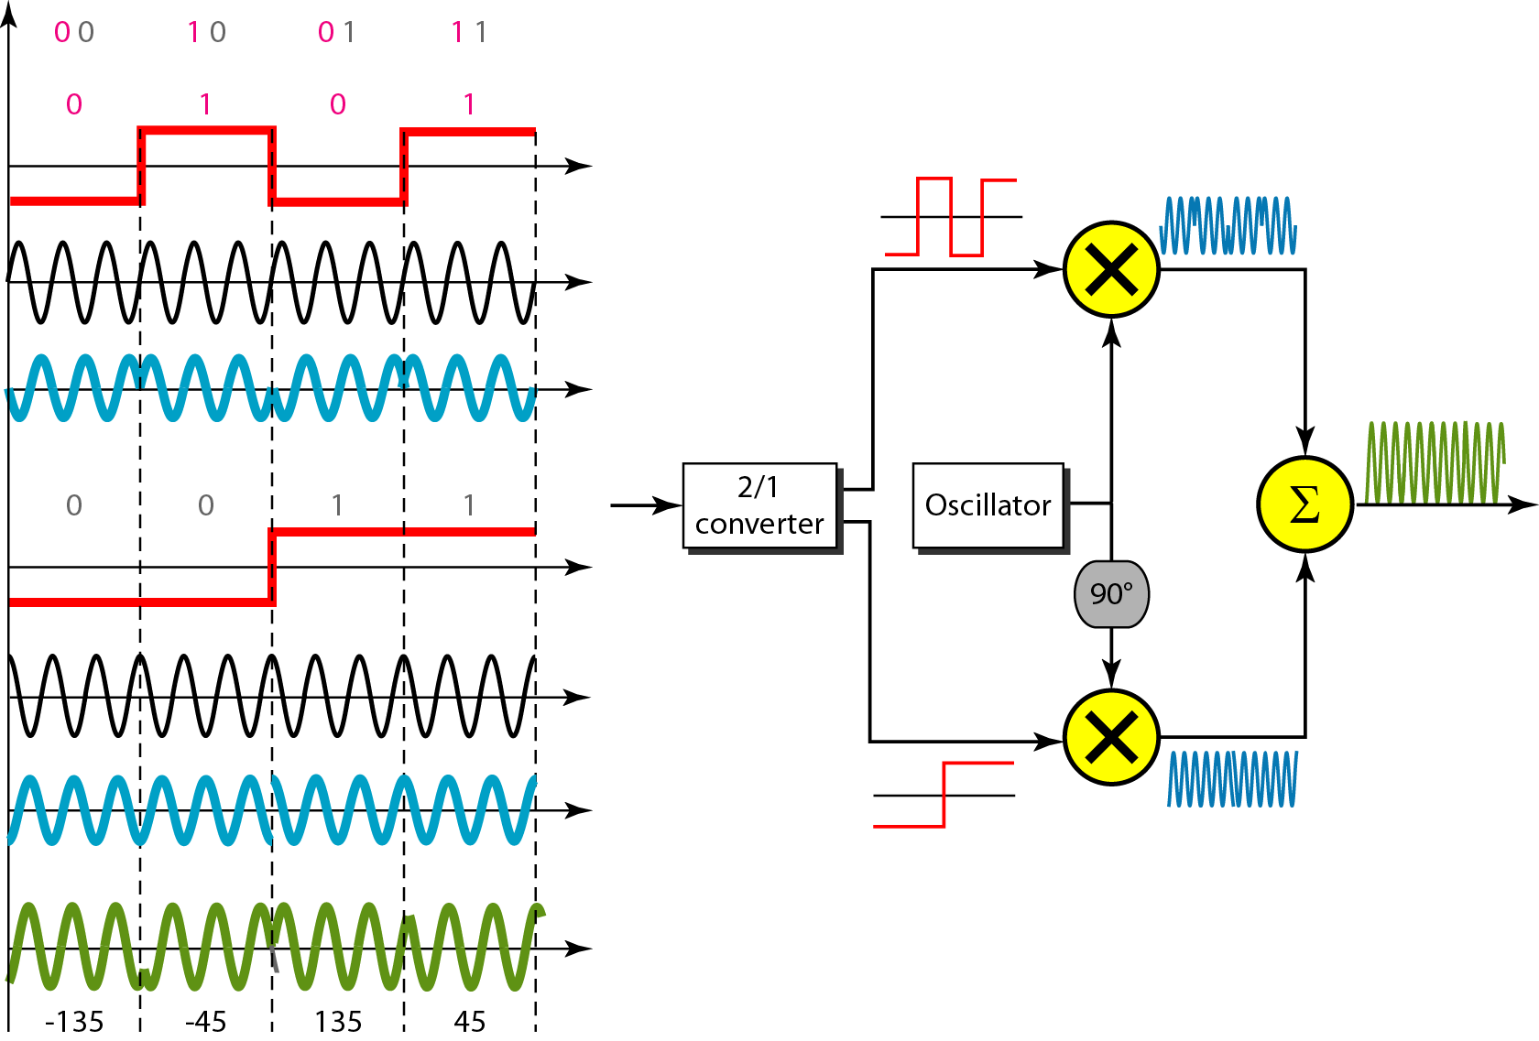
Quadrature PSK
To increase the bit rate, we can code 2 or more bits onto one signal element.
In QPSK, we parallelize the bit stream so that every two incoming bits are split up and PSK a carrier frequency. One carrier frequency is phase shifted 90º from the other - in quadrature.
The two PSKed signals are then added to produce one of 4 signal elements. L = 4 here.
Figure QPSK and its implementation

Slide 13
Gaussian frequency-shift keying
Gaussian frequency-shift keying is a type of FSK modulation which uses a Gaussian filter to shape the pulses before they are modulated. This reduces the spectral bandwidth and out-of-band spectrum, to meet adjacent-channel power rejection requirements. Bluetooth radio chip employs the GFSK modulation type.
Gaussian frequency-shift keying (GFSK) filters the data pulses with a Gaussian filter to make the transitions smoother.
In ordinary non-filtered FSK, at a jump from −1 to +1 or +1 to −1, the modulated waveform changes rapidly, which introduces large out-of-band spectrum.
In GFSK, spectral width is limited due to filter. Here fc climbs slowly and will attain value equal to fd.
If we change the pulse going from −1 to +1 as −1, −.98, −.93 ..... +.93, +.98, +1, and we use this smoother pulse to determine the carrier frequency, the out-of-band spectrum will be reduced.

Slide 14
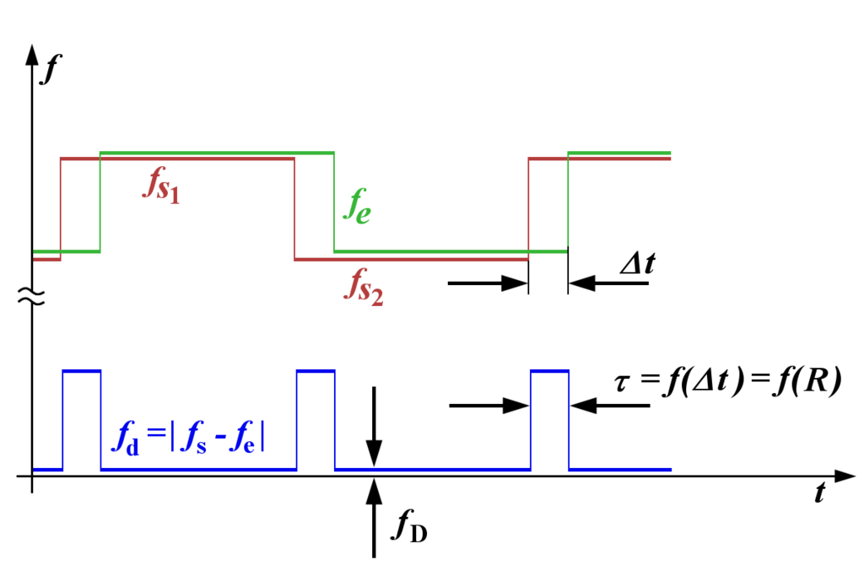
f_{d} is the frequency deviation of original frequency to error frequency

Slide 15
Self assessment
a. If a communications system uses 16 symbols, how many bits does each symbol represent?
b. If the same system has a symbol rate of 10 000 baud, what is the data rate?

Slide 16
Solution
a. If there are 16 symbols, then each of these can represent 4 bits, because 16 = 2⁴.
b. There are 10 000 symbols per second, and each symbol represents 4 bits, so the number of bits per second is 4 × 10 000 = 40 000. So the data rate (or bit rate) is 40 000 bit s⁻¹, also written 40 kbit s⁻¹.

Slide 17
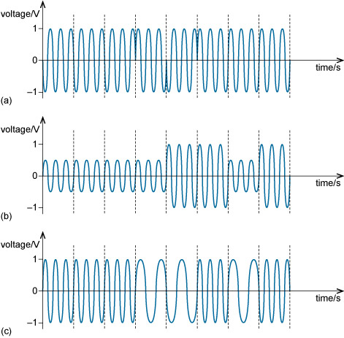
For each example, decide which modulation scheme has been used and, based on the figures, work out what binary data each of these represents.

Slide 18
Solution
Waveform (a) is an example of a BPSK-modulated waveform representing the data:
0 0 0 1 0 1 1 1.
Waveform (b) is an example of a BASK-modulated waveform representing the data:
0 0 0 0 1 1 0 1.
Waveform (c) is an example of a BFSK-modulated waveform representing the data:
1 1 1 0 0 1 0 1.

Slide 19
Quadrature amplitude modulation (QAM)
It is possible to combine ASK, FSK and PSK. One benefit of combining different modulation methods is to increase the number of symbols available. Increasing the number of available symbols is a standard way to increase the bit rate, because increasing the number of symbols increases the number of bits per symbol. It is rare for all three methods to be combined, but very common for ASK and PSK to be combined to create Quadrature amplitude modulation (QAM).
QAM is based on the application of ASK and PSK to two sinusoidal waves of the same frequency but with a phase difference of 90°. Sinusoidal waves 90° apart are said to be in a quadrature phase relationship. It is customary to refer to one of these waves as the I wave, or in-phase wave or component, and the other as the Q wave, or quadrature wave or component

Slide 20
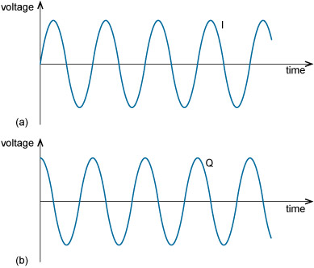
Quadrature amplitude modulation (QAM)
You may recognize the I wave in Figure as a sine function and the Q wave as a cosine function. These functions are said to be orthogonal to each other. If two signals are orthogonal, when they are transmitted simultaneously one can be completely recovered at the receiver without any interference from the other.

Slide 21
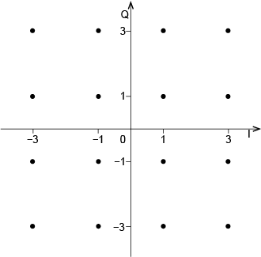
The set of symbols in QAM can be conveniently represented on a signal constellation diagram. This is a plot of the I and Q amplitudes with I on the horizontal axis and Q on the vertical axis. Each dot in Figure 1.8 is a symbol, as it represents a unique combination of amplitude and phase of the I and Q waves. So, in each symbol period, only one of the ‘dots’ is transmitted. As there are 16 symbols, this version of QAM is called 16-QAM.
To understand what each dot in the diagram represents, take the top left one. This represents a symbol where the Q wave is at an amplitude of 3 and the I wave is at an amplitude of –3. The minus sign means the I wave is inverted (or phase shifted by 180°) relative to the I wave in Figure.
As the number of symbols increases, more data bits are transmitted per symbol. For example, 64-QAM is a QAM scheme with 64 symbols, and 256-QAM is a scheme with 256 symbols. 256-QAM conveys 8 bits per symbol (as 256 = 2⁸), so achieving twice the data rate of 16-QAM.

Slide 22
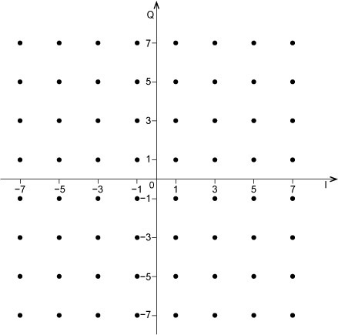
How many bits are represented by each symbol in 64-QAM? Sketch a constellation diagram for 64-QAM.
For 64-QAM, the number of symbols M = 64. There are six bits per symbol, as M = 2^{n} and 64 = 2⁶.
A constellation diagram for 64-QAM might look like this:

Slide 23
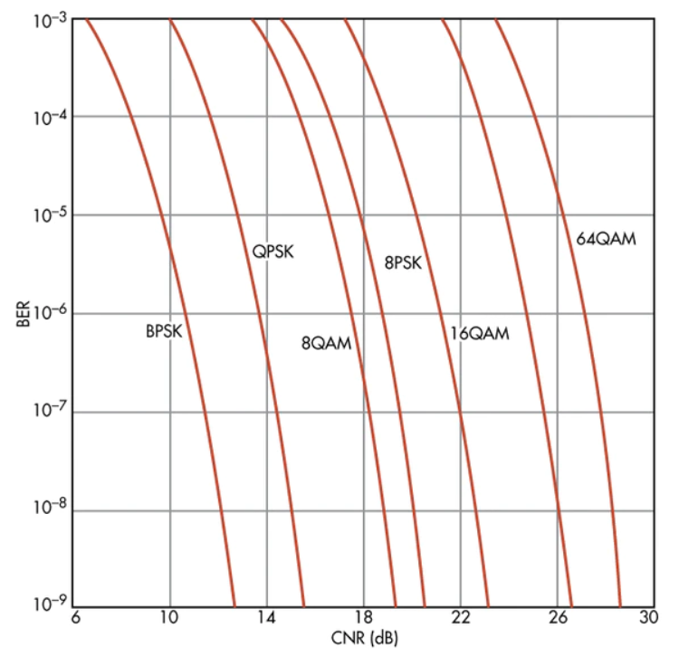
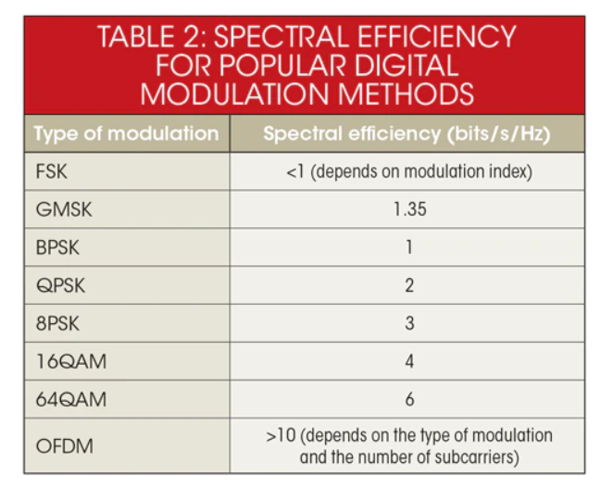
The most commonly used family of modulation formats are quadrature amplitude modulation, QAM. The number preceding the QAM designation indicates the number of states the digitally modulated signal can assume, and ranges from 4-QAM (also known as QPSK) to 256-QAM.
16-QAM, 64-QAM, and 128-QAM, in 4G, and 256-QAM additionally in 5G. The constellation points are closer together with high-order QAM and so are more susceptible to noise and other interference. Thus high-order QAM can deliver more data, but less reliably than lower-order QAM.

Slide 24
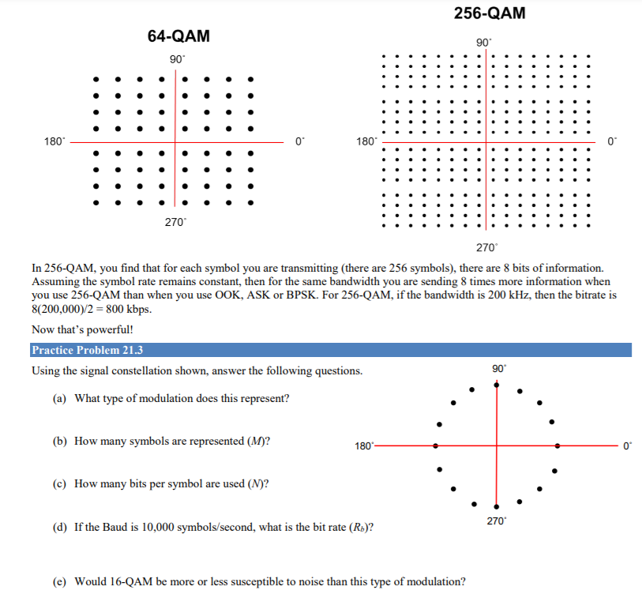
Notes:
Some modulation methods are more immune to noise than others. Amplitude modulation methods like ASK/OOK and QAM are far more susceptible to noise so they have a higher BER for a given modulation. Phase and frequency modulation (BPSK, FSK, etc.) fare better in a noisy environment so they require less signal power for a given noise level

Slide 25
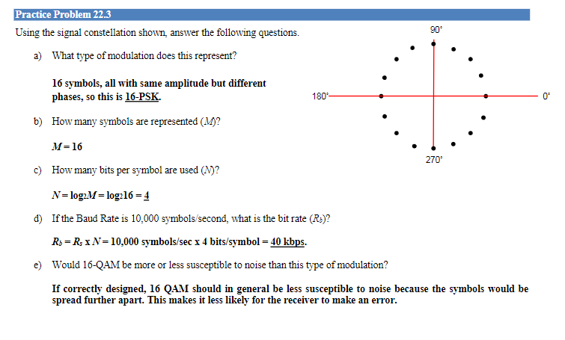
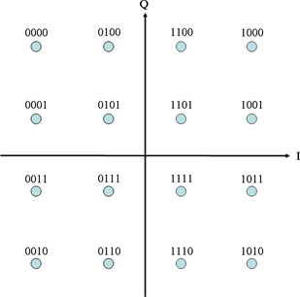

Slide 26
If the bandwidth for 8-QAM and 8-PSK is BW=2Rb/3, then i) what is the bandwidth of 16-QAM and 16-PSK? ii) If a bit stream of 64 kb/s is to be transmitted, how much bandwidth is required in each case?
iii) How many symbols are represented (M) for 8-QAM and 16- QAM modulation?
iv) How many bits per symbol are used (K) for 8-PSK and 16-PSK?
v) If the Baud is 10000 symbols/s, what is bit rate (Rb) for 8-QAM and 16-QAM?
v) Draw the signal constellation diagram for both 16-QAM and 16-PSK.

Slide 27
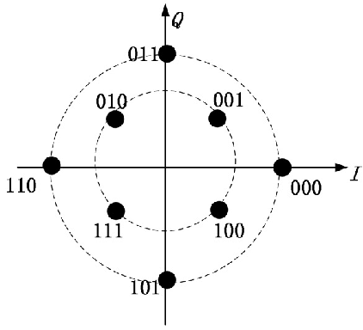
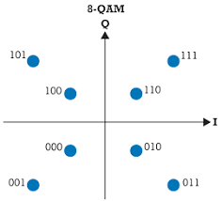
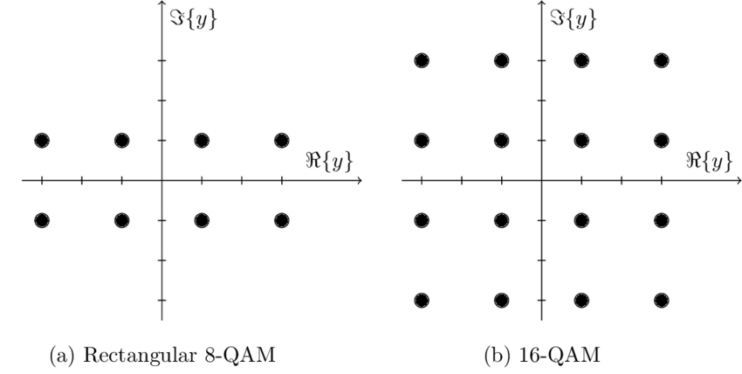
Constellation diagram for Circular 8 QAM and Rectangular 8 QAM
the demodulator must detect both phase and amplitude. Also the fact that the amplitude varies means that a linear amplifier is required to amplify the signal.

Slide 28
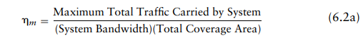
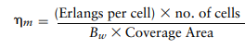
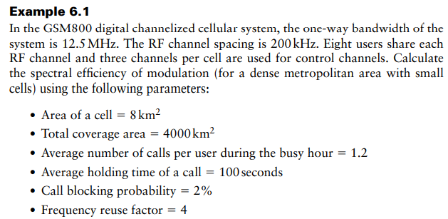
Spectral Efficiency of Modulation

Slide 29
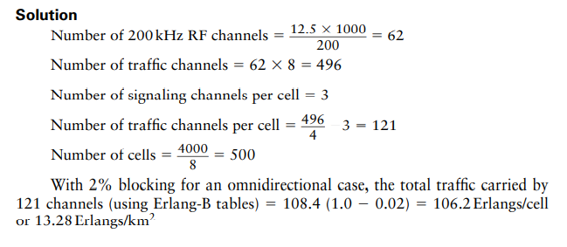
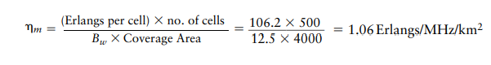

Slide 30
Thank You

Slide 31
Wireless Network
By-
Dr. Jesmin Akhter
Professor
Institute of Information Technology
Jahangirnagar University

Slide 32
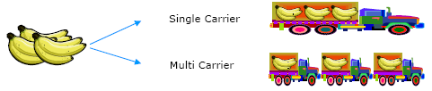
Orthogonal Frequency Division Multiplexing IEEE 802.11a and 802.11g
Orthogonal Frequency Division Multiplexing (OFDM) is a multi-carrier modulation scheme that transmits data over a number of orthogonal subcarriers.
A conventional transmission uses only a single carrier modulated with all the data to be sent.
OFDM breaks the data to be sent into small chunks, allocating each sub-data stream to a sub-carrier and the data is sent in parallel orthogonal sub-carriers.
As illustrated in Figure 1, this can be compared with a transport company utilizing several smaller trucks (multi-carrier) instead of one large truck (single carrier).
Fig.1 Single carrier vs. multi-carrier transmission
Notes:
In telecommunications and computer networks, multiplexing is a method by which multiple analog or digital signals are combined into one signal over a shared medium.

Slide 33
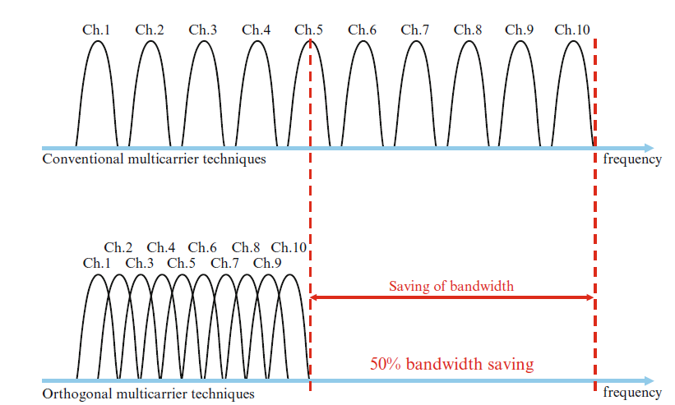
OFDM Versus FDM
The essential property of the OFDM signal is the orthogonality between the subcarriers.
The use of orthogonal subcarriers allows more subcarriers per bandwidth resulting in an increase in spectral efficiency.
In a perfect OFDM signal, Orthogonality prevents interference between overlapping carriers.
In FDM systems, any overlap in the spectrums of adjacent signals will result in interference. In OFDM systems, the subcarriers will interfere with each other only if there is a loss of orthogonality.
Notes:
Each OFDM subcarrier is 312.5 KHz, Subcarrier spacing is equal to the reciprocal of the symbol time. As a result of the longer symbol time, the subcarrier size and spacing decreases from 312.5 KHz to 78.125 KHz. The narrow subcarrier spacing allows better equalization and therefore enhanced channel robustness. Because of the 78.125 KHz spacing, an OFDMA 20 MHz channel consists of a total of 256 subcarriers
The guard interval, containing cyclic prefix may be shortened from 0.8μs to 0.4μs, thus increasing actual data rate to 72.25Mbps, or 150Mbps in 40MHz
The simplest meaning of orthogonal is “at right angles”. A broader definition is that things are independent from each other, or separable.
How is this separation done? Using a Fourier Transform, usually in the form of an FFT (Fast…). This allows us to have a number of very tightly spaced carriers, but we still can recover the modulation from each carrier. The limit on how tight the carriers can be spaced is the rate of modulation; if the modulation is 15 kHz, the carrier spacing has to be 15 kHz (note that it’s not “at least 15 kHz”, it’s exactly 15 kHz).

Slide 34
How OFDM Subcarriers Work
OFDM divides a given channel into many narrower subcarriers. The spacing is such that the subcarriers are orthogonal, so they won’t interfere with one another despite the lack of guard bands between them. This comes about by having the subcarrier spacing equal to the reciprocal of symbol time.
This tells us that the spacing of the subcarriers is directly related to the useful symbol time (more specifically, the amount of time the transmitter spends performing IFFT). Because of this relationship, the resulting sinc frequency response curves from each subcarrier create signal nulls in the adjacent subcarrier frequencies thus preventing inter-carrier interference (ICI).
OFDM is a form of frequency division multiplexing (FDM), which typically requires guard bands between carriers and specialized hardware with bandpass filters to remove interference. OFDM eliminates the need for these which increases spectral efficiency and reduces cost and complexity of the system

Slide 35
How OFDM Subcarriers Work
To illustrate, let's take a look at the Wi-Fi OFDM channelization. Each 20 MHz channel, whether it's 802.11a/g/n/ac, is composed of 64 subcarriers spaced 312.5 KHz apart.
And we also know that a standard Wi-Fi symbol is 4us, composed of 3.2us IFFT (useful symbol duration) and 0.8us long guard interval., "subcarrier spacing is equal to the reciprocal of symbol time." Let's examine:
Subcarrier spacing = 312.5 KHz
Useful symbol duration = 3.2us IFFT
Reciprocal = 1 cycle / 0.0000032 sec = 312,500 cycles/sec = 312.5 KHz
Since IFFT is used for modulation the spacing of the subcarriers is such that at the frequency where we evaluate the received signal all other signals are zero.

Slide 36
OFDM offers many advantages over single-carrier modulations:
1. It elongates the symbol period so that the signal is more robust against intersymbol interference caused by channel dispersions and multipath interference. As long as the subcarriers preserve their orthogonality, adjacent subcarriers do not interfere with each other.
2. It divides the entire frequency band into narrow bands so that it is less sensitive to wide-band impulse noise and fast channel fades.
3. Splitting the channel into narrowband channels enables significant simplification of equalizer design in multipath environments.
Notes:
"dispersion" is used to describe any process by which an electromagnetic signal propagating in a physical medium is degraded because the various wave components (i.e., frequencies) of the signal have different propagation velocities within the physical medium
The concepts of delay spread that causes channel dispersion
Delay spread σ_{τ} and coherent bandwidth B_{c} are parameters that describe the time dispersion nature of the mobile channel, and their values with respect to the transmitted signal bandwidth B_{s} and the symbol duration T_{s} can help determine if the channel is experiencing flat fading or frequency-selective fading.
In OFDM, Orthogonal subcarriers allow their spectrums to overlap which achieves the high spectral efficiency. As long as the subcarriers preserve their orthogonality, adjacent subcarriers do not interfere with each other.
The key idea of OFDM is that a single user would make use of all orthogonal subcarrier in divided frequency bands.
Therefore, the data rate can be increased significantly.
Since the bandwidth is divided into several narrower subchannels, each subchannel requires a longer symbol period. Therefore OFDM systems can overcome the intersymbol interference (ISI) problem.
As a consequence, the OFDM system can result in lower bit error rates but higher data rates than conventional communication systems
An equalizer allows the sound in specified frequency bands to be amplified or reduced, in order to adjust the quality and character of the sound.

Slide 37
4. Different modulation formats and data rates can be used on different subcarriers depending on the noise level of individual subbands (the symbol periods are kept the same). In serial transmission, certain types of noise (such as time varying tone interference) may cause an entire system to fail; the parallel OFDM system can avoid this problem by adaptively reducing the data rate of the affected subbands or dropping them.
5. OFDM can be implemented digitally using an inverse discrete Fourier transform and discrete Fourier transform (IDFT/DFT) pair (via the efficient fast algorithm IFFT/FFT pair), which greatly reduces the system complexity.
Notes:
single-tone interference: An undesired discrete frequency appearing in a transmission channel.
The single-tone interference frequency is the frequency that appears in the channel regardless of the nature of the source.
channel is caused by signaling tone in its own channel or in an adjacent
channel, or both; or from such sources as carrier leak, crosstalk, and
induction from power lines

Slide 38
Disadvantages
Adding carriers with different frequencies and modulation gives large amplitude variations. This is the Peak Power Problem of OFDM called Peak to Average Power Ratio (PAPR)
Multipath also has a negative effect on OFDM, especially when clients are mobile. The orthogonality of the subcarriers can be lost.
It is sensitive to Doppler shift. Without proper orthogonality between subcarriers, inter-carrier interference (ICI) would result from this doppler shifting. The fix for this is to include a cyclic prefix with each symbol, which acts as guard interval to protect the OFDM signals from intersymbol interference.
Notes:
The Doppler effect (or the Doppler shift) is the change in frequency or wavelength of a wave for an observer who is moving relative to the wave source. It is named after the Austrian physicist ChristianDoppler, who described the phenomenon in 1842.
Use of cyclic prefix is a key element of enabling the OFDM signal to operate reliably. The cyclic prefix acts as a buffer region or guard interval to protect the OFDM signals from intersymbol interference.

Slide 39
OFDM APPLICATIONS
OFDM is digital transmission technique developed into a popular scheme for data rate, wideband digital communication systems.
Nowadays, OFDM is mainly used for one to many (broadcast) communications like radio or television broadcasting.
OFDM is also is used in wireless internet modem and this usage is called like 802.11a/g/n/ac.
Additionally OFDM is used in IEEE 802.16 Broadband remote access framework.
Notes:
Examples are digital broadcasting systems such as DAB( Digital Audio Broadcasting) and DVB(Digital Video Broadcasting).
HiperLAN2 is the all new high performance radio technology, specifically suited for operating in LAN environments. HiperLAN2 is a technology being developed within the European Telecommunications Standardisation Institute (ETSI).
Equalization is the process of adjusting the balance between frequency components within an electronic signal. The most well known use of equalization is in sound recording and reproduction but there are many other applications in electronics and telecommunications.

Slide 40
A baseband OFDM transmission model
x₀(t)
Σ
S/P
x₁(t)
x(t)
Channel
………
x_{Nc-1}(t)
f_{q}=q∆f
r(t)
Fig.3
f_{k}=k∆f
A baseband OFDM transmission model is shown in Figure 3. It basically consists of a transmitter (modulator, multiplexer and transmitter), the wireless channel, and a receiver (demodulator).

Slide 41
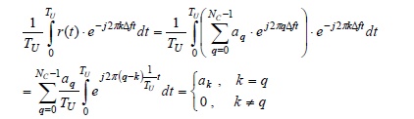
A baseband OFDM transmission model
x_{q} is the received subcarrier and x_{k} represents the local oscillator.
When integrating received power over one symbol period, T_{U}, the output of the correlators is zero for any combination, except when k = q.

Slide 42
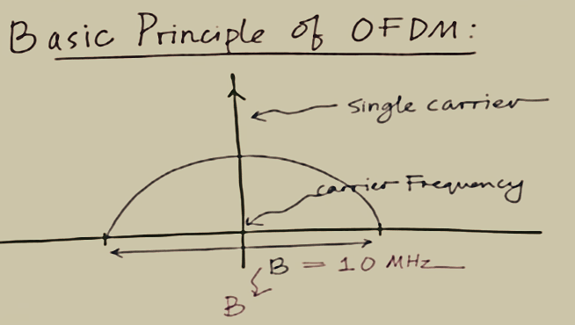
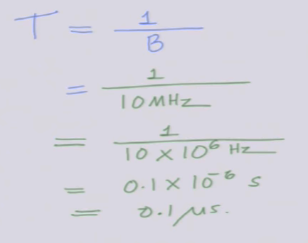
symbol period,

Slide 43
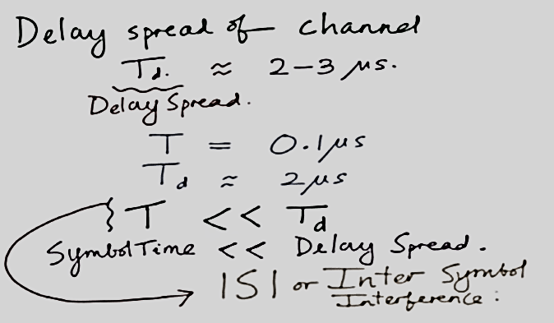

Slide 44
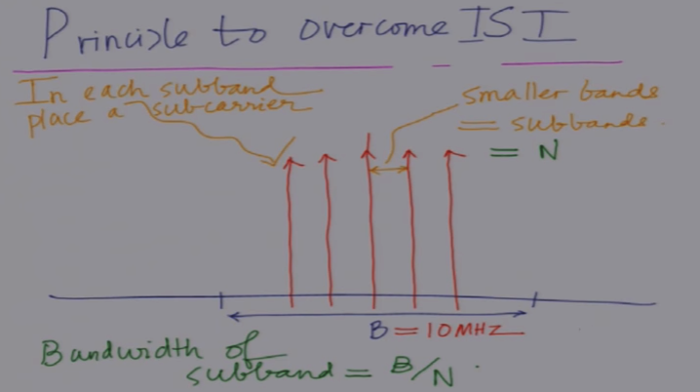
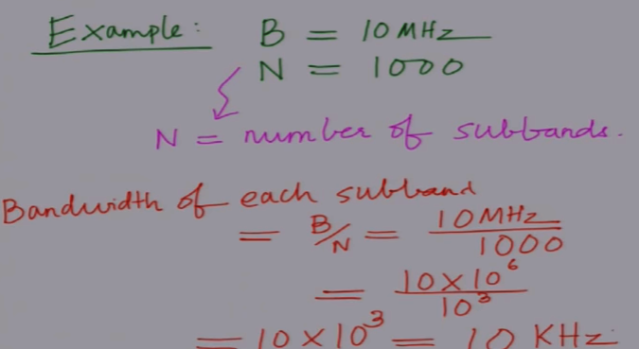

Slide 45
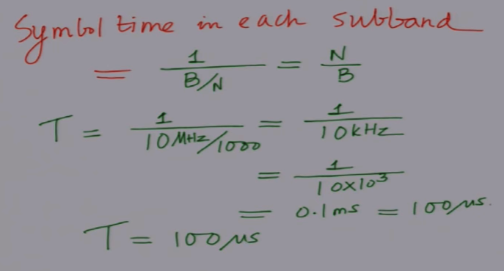
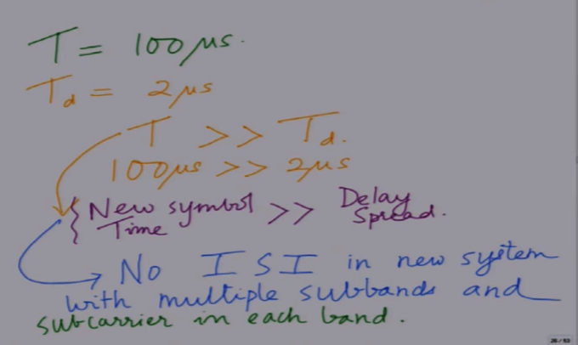

Slide 46
Outline
Mobile Cellular Network
Basic of Mobile Cellular Network
Interferences In Mobile Cellular Network
Channel Allocation Scheme
TYPES OF TRANSMISSION MODE
Cell sectoring

Slide 47
Basic of Mobile Cellular Network
Hexagonal Cells in a continuous fashion
Break the metropolitan area into small areas
Each area is approximated with a hexagonal cell.
A base station is located at the center of each cell.
Each cell is assigned only a fraction of the total number of channels.
Cells that are sufficiently far apart can reuse the same frequency.

Slide 48
Why Hexagonal Cell?
Hexagonal-shaped communication cells are artificial and that such a shape cannot be generated in the real world. Engineers draw hexagonal-shaped cells on a layout to simplify the planning and design of a cellular system because it approaches a circular shape that is the ideal power coverage area. The circular shapes have overlapped areas which make the drawing unclear. The hexagonal shaped cells fit the planned area nicely with no gap and on overlap between the cells. The real cell has irregular shape because of natural, and man made obstacle in service area.
R
R
R
Cell
R
R
(a) Ideal cell
(b) Actual cell
(c) Different cell models
Factitious

Slide 49
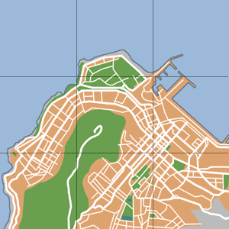
Cell Clusters
Cells in a cellular network are generally “grouped” together into cell clusters. Service areas are normally divided into clusters of cells to facilitate system design and increased capacity.
Cell clusters are used in frequency planning for the network
The pattern of cluster is repeated throughout the network.
Entire BW is used within a cluster.
Coverage area of cluster called a ‘footprint’
Cellular networks are generally designed as a repeated cluster pattern where the same frequencies will be re-used
The number of cells in a cluster are typically 4,7, 12 or 21……
3
2
7
2
4
1
6
3
1
7
3
2
7
5
2
4
5
6
4
1
6
3
1
7
3
2
7
5
2
4
5
6
4
1
6
3
1
7
3
2
7
5
4
5
6
4
1
6
5

Slide 50
Frequency Reuse Distance
The minimum distance which allows the same frequency to be reused is called Frequency Reuse Distance. It depends on many factors such as the number of co-channel cells in the vicinity of the center cell, the type of geographic land outline, antenna height and the transmitted power at each cell site.

Slide 51
Frequency Reuse Distance
R
Cluster
For hexagonal cells, the reuse distance is given by
F7
F2
F6
F1
F3
F1
where R is cell radius and N is the reuse pattern (the cluster size or the number of cells per cluster).
F5
F4
F7
F2
F3
Reuse ratio is
F6
F1
F1
Reuse distance D
F5
F4

Slide 52
Determine two parameters i and j, called shift parameters
Starting from any cell, move i cells along any one of the six emanating chains of hexagons. Turn clock (or counter clock)-wise by 60 degree and then move j cells along the chain. The destination is the nearest co-channel cell
By repeating this pattern, clusters of cells are formed such that each cell within a cluster is assigned a different set of frequencies. Such a cluster is called a frequency reuse pattern.

Slide 53
Example-1
7 cell reuse cluster
where
Reuse factor
i = 2, j = 1
Note: i and j are integers
=7

Slide 54
Example-2
19 cell reuse cluster
A
A
A
A
A
A
A
Shift Parameter: i = 3, j = 2
= 19

Slide 55
If all the cell sites transmit the same power then N increases and the frequency reuse distance D increases. This increased D reduces the chance that the co-channel interference may occur. Theoretically a large N is desired. However the total number of allocate channel is fixed. When N is too large, the number of channel assigned to each of N cells becomes small and carried traffic of that cell will be smaller.
Exam date: 18/08/2023 file 7 8 9 upto 55

Slide 56
Interferences In Mobile Cellular Network
Co-site Channel Interferences
Adjacent Channel Interferences
Co-Channel Channel Interferences

Slide 57
Co-site Channel Interferences
Mutual interferences created by the users inside a cell is called co-site channel interferences.
Since users are very closed in cell therefore separation between carries within a cell should be wide enough to avoid interferences.
At the same time uplink and down link carriers of an user are separated by 45MHz.

Slide 58
Adjacent Channel Interferences
Interferences created by the users of two adjacent cells are called adjacent channel interferences.
Adjacent channel interference results from imperfect receiver filters which allow nearby frequencies to leak into the passband.
The problem can be particularly serious if an adjacent channel user is transmitting in very close range to a subscriber's receiver. This is referred to as the near-far effect, where a nearby transmitter captures the receiver of the subscriber. Alternatively, the near-far effect occurs when a mobile close to a base station transmits on a channel close to one being used by a weak mobile.
Because of small distance between adjacent cells an wide band gap should be maintained between carries of adjacent cell to avoid interferences.
Adjacent channel interference can be minimized through careful filtering and channel assignments.
Notes:
Passband - a frequency band within which signals are transmitted by a filter without attenuation.

Slide 59
Co-channel Interferences
Interferences created by the users of two co-channel cells are called co-channel interferences.
Because of use of same carries, huge interference is created despite of long distance between to co-cell.
The distance between co-cell increases with increase in N, the no of cells in a cluster.
It can be reduced using sectored cells.

Slide 60
Co-channel Interference
Determine the minimum distance at which a frequency can be reused with no interference, called the co-channel reuse distance (D).
Signal-to-interference ratio, (C / I), is an index of channel interference.
A
A
A
A
A
A
A
Shift Parameter: i = 3, j = 2

Slide 61
First tier co-channel Base Station
Second tier co-channel Base Station
R
D₆
D₅
D₁
D₄
Mobile Station
D₂
D₃
Serving Base Station

Slide 62
Worst Case of Co-channel Interference
D₆
R
D₅
D₁
Mobile Station
D₄
D₂
D₃
Serving Base Station
Co-channel Base Station

Slide 63
Co-channel Interference
Co-channel interference ratio is given by
where I is co-channel interference and M is the maximum number of co-channel interfering cells. We know,
C α R^{-γ}
Therefore C=K. R^{-γ;} where K is a constant and γ is path loss slope,
γ = 2~5, Similarly, I_{k} = K. D_{k}^{-γ}
For M = 6, C/I is given by,
C
1
=
I
⎛
−γ
M
D
⎞
∑
⎜
⎟
k
⎝
R
⎠
k
=
1

Slide 64
Co-channel Interferences
To reduce co-channel interference, co-channel cell must be separated by a minimum distance.
When the size of the cell is approximately the same
co-channel interference is independent of the transmitted power(Can’t remove it by increasing power)
co-channel interference is a function of
R: Radius of the cell
D: distance to the center of the nearest co-channel cell
Increasing the ratio q=D/R, the interference is reduced.
q is called the co-channel reuse ratio

Slide 65
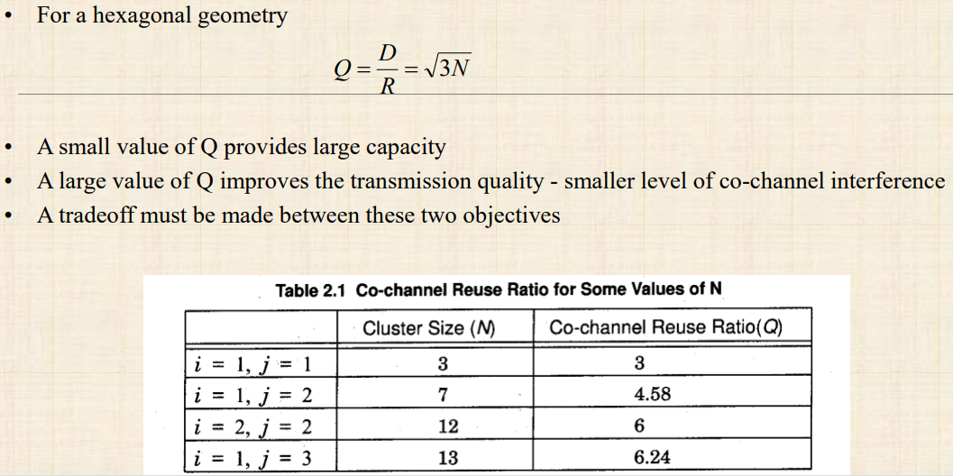
Co-channel Interferences

Slide 66
Channel Allocation Scheme
Fixed Channel Allocation (FCA)
Dynamic Channel Allocation (DCA)
Hybrid Channel Allocation (HCA)

Slide 67
Fixed Channel Allocation (FCA)
In FCA schemes, permanently assign a fixed set of channels to each cell and reuse them in the co-channel cells
A user is assigned an unoccupied channel on demand, which is relinquishes after the call is over
As this allocation is static and can not be changed, If the number of calls exceeds the channel set for a cell, the excess calls are blocked
For efficient operation, FCA systems typically allocate channels in a manner that maximizes frequency reuse. Thus, in a FCA system, the distance between cells using the same channel is the minimum reuse distance for that system
Notes:
Fixed: FCA, fixed channel allocation: manually assigned by the network operator. FCA can be extended into a DCA system by using a borrowing strategy in which a cell can borrow channels from the neighboring cell which is supervised by Mobile Switching Center (MSC).

Slide 68
Fixed Channel Allocation (FCA)
Does not solve “hot spot” problem or localized traffic congestion.
Consider a case in which two adjacent cells are allocated N channels each. There can be situations in which one cell has a need for N+k channels while the adjacent cell only requires N-m channels (for positive integers k and m). In such a case, k users in the first cell would be blocked from making calls while m channels in the second cell would go unused.
One approach to address this problem is to borrow free channels from neighboring cells.
Notes:
Fixed: FCA, fixed channel allocation: manually assigned by the network operator. FCA can be extended into a DCA system by using a borrowing strategy in which a cell can borrow channels from the neighboring cell which is supervised by Mobile Switching Center (MSC).

Slide 69
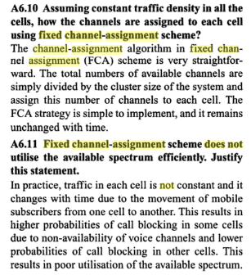
Notes:
Wireless Communications
By Singal

Slide 70
Dynamic Channel Assignment (DCA)
No cell has a proprietary set of channels. In DCA schemes, all channels are kept in a central pool and are assigned dynamically to new calls as they arrive in the system. After each call is completed, the channel is returned to the central pool
It is fairly straightforward to select the most appropriate channel for any call simply based on current allocation and current traffic, with the aim of minimizing the interference
Different cost functions are used for selecting one of the candidate channels for assignment
DCA schemes can be centralized or distributed.
The centralized DCA scheme involves a single controller selecting a channel for each cell;
The distributed DCA scheme involves a number of controllers scattered across the network (MSCs).
Notes:
proprietary -registered

Slide 71
Dynamic Channel Assignment (DCA)
Two problems that typically occur with DCA based systems.
First, DCA methods typically have a degree of randomness associated with them and this leads to the fact that frequency reuse is often not maximized unlike the case for FCA systems in which cells using the same channel are separated by the minimum reuse distance.
Secondly, DCA methods often involve complex algorithms for deciding which available channel is most efficient. These algorithms can be very computationally intensive and may require large computing resources in order to be real-time.
Notes:
proprietary -registered

Slide 72
Hybrid Channel Allocation (HCA)
HCA schemes are the combination of both FCA and DCA techniques.
In HCA schemes, the total number of channels available for service is divided into fixed and dynamic sets.
The fixed set contains a number of nominal channels that are assigned to cells as in the FCA schemes and, in all cases, are to be preferred for use in their respective cells.
Request for a channel from the dynamic set is initiated only when the cell has exhausted using all its channels from the fixed set.
Example: When a call requires service from a cell and all of its nominal channels are busy, a channel from the dynamic set is assigned to the call.

Slide 73
Channel Borrowing Scheme
Channel Borrowing is one of the most straightforward hybrid allocation schemes. Here, channels are assigned to cells just as in fixed allocation schemes. If a cell needs a channel in excess of the channels previously assigned to it, that cell may borrow a channel from one of its neighboring cells given that a channel is available and use of this channel won't violate frequency reuse requirements.

Slide 74
Channel Borrowing Scheme
The major problem with channel borrowing is that when a cell borrows a channel from a neighboring cell, other nearby cells are prohibited from using the borrowed channel because of co-channel interference. This can lead to increased call blocking over time.
To reduce this call blocking penalty, algorithms are necessary to ensure that the channels are borrowed from the most available neighboring cells; i.e., the neighboring cells with the most unassigned channels.

Slide 75
Channel Borrowing Scheme
- A channel is borrowed from a neighboring cell provided it does not interfere with existing calls - Performance suffers under heavy traffic conditions
X
C
B
E
B:{b1, b2,..}
a3
A
C
B
D
G
A
a3
A:{a1, a2,…}
E
F
D
B
E
F
A
C
B
E
X
G
A
C
F
D
G
E
F
D
(a)
(b)
FCA: A-G denote different sets of channels permanently assigned to cells
Borrowing: Channel a3 is borrowed by B from A. Cells marked X are prohibited from using a3

Slide 76
Thank You

Slide 77
Wireless Network
By-
Dr. Jesmin Akhter
Professor
Institute of Information Technology
Jahangirnagar University

Slide 78
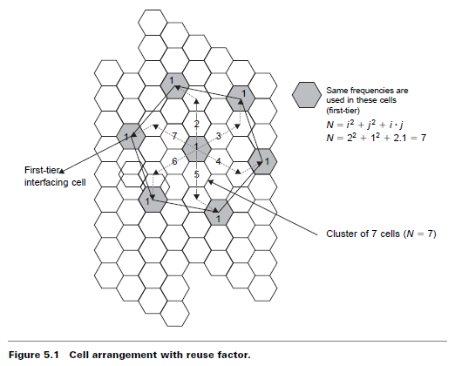
Cellular Systems
Book -(Vijay Garg)

Slide 79
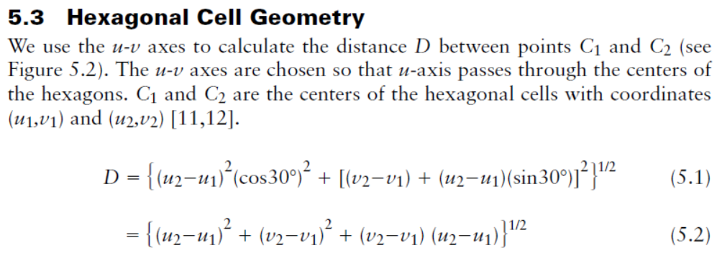
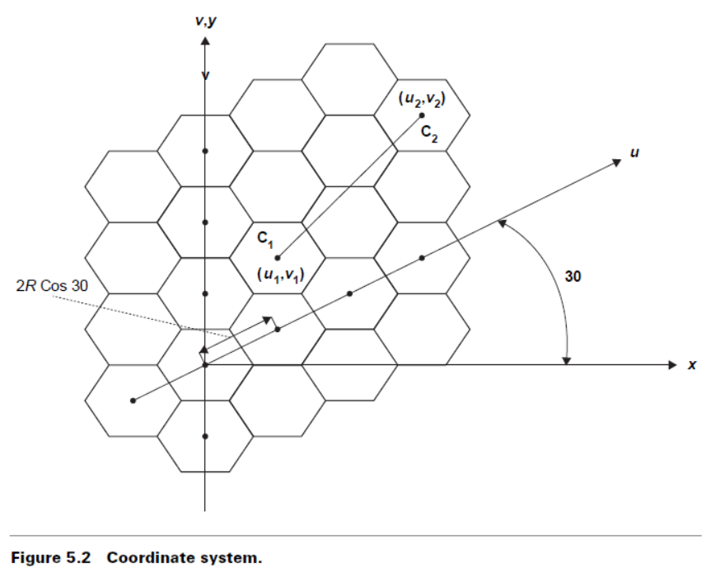

Slide 80
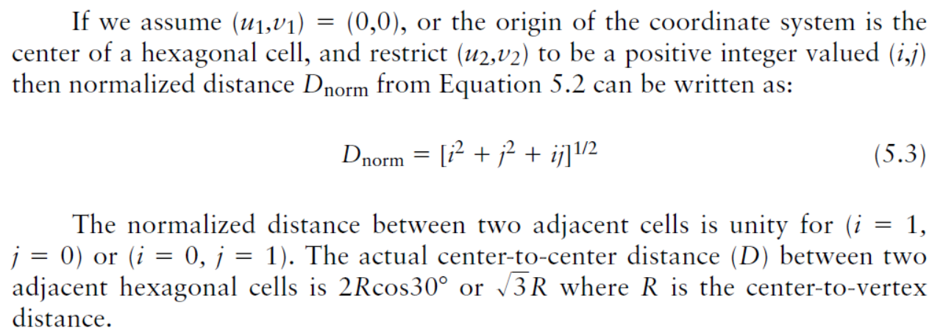
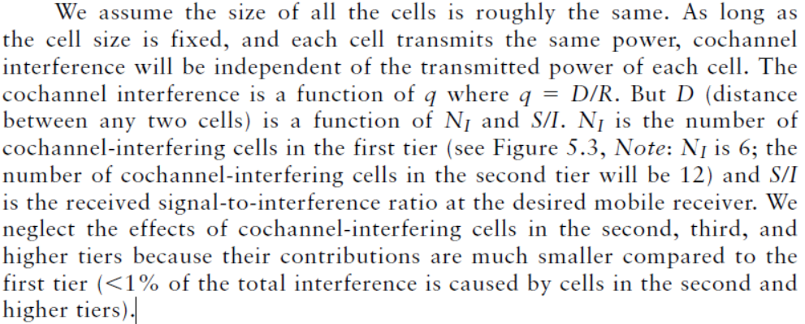

Slide 81
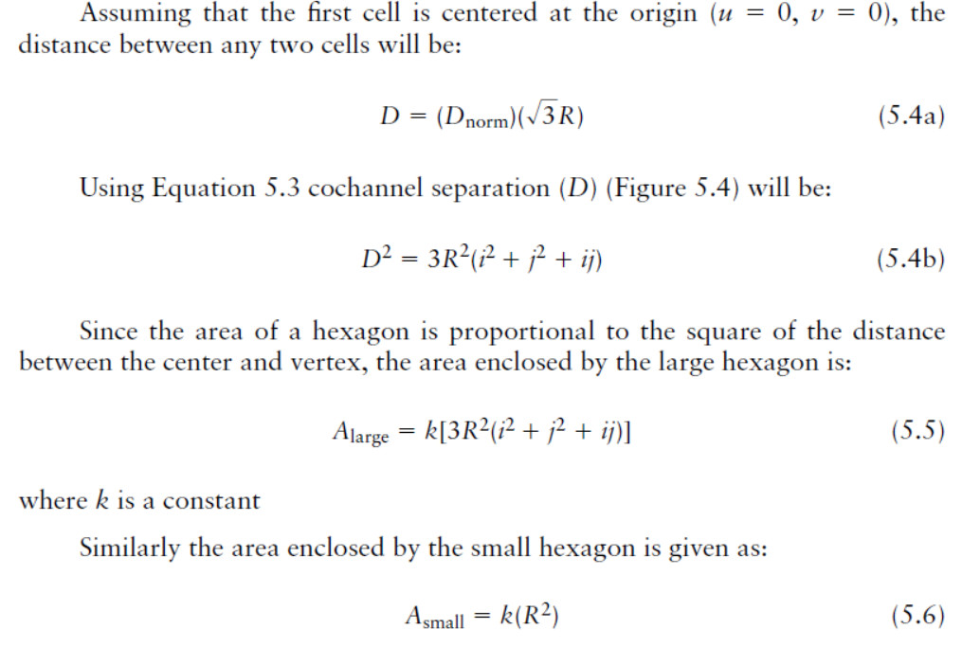

Slide 82
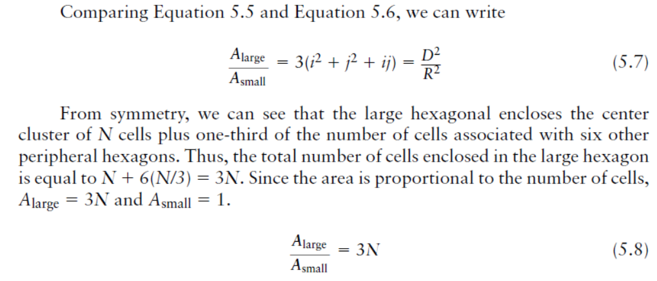

Slide 83
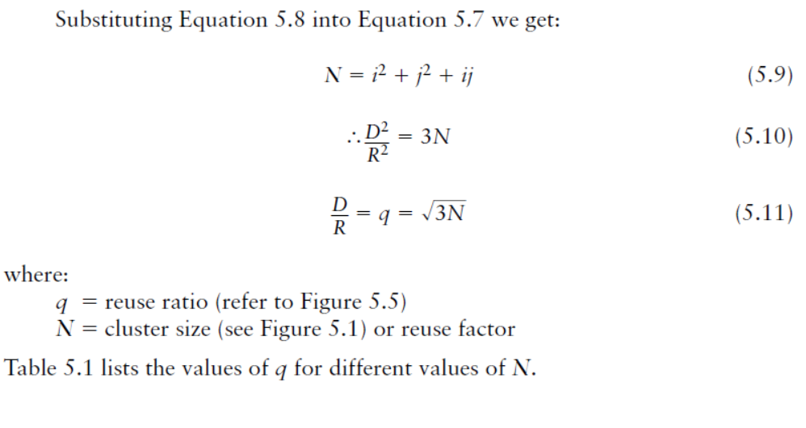

Figure 5.5 Relationship between q and N.

Slide 84



Slide 85


Slide 86

N =7

Slide 87


(Book Vijay Garg)

Slide 88


Slide 89


Slide 90
Why cell splitting and sectoring?
As users increases channel capacity decreases.
Techniques are needed to provide extra channels.
Cell splitting and sectoring increases capacity

Slide 91
Cell sectoring
To overcome some limitations like cochannel interference, cell sectoring is done.
Cell sectoring involves replacing an omni- directional antenna at the base station by several directional antennas, each radiating within a specified sector. By using directional antennas power is transmitted in single desired direction decreasing number of interfering co-channel cells and co-channel interference
Advantages:
It improves S/I ratio.
It reduces interference which increases capacity.
It enables to reduce the cluster size and provides an additional freedom in assigning channels.

Slide 92
Limitations:
Increased number of antennas at each base station.
Decrease in trunk efficiency.
Loss of traffic.
Since sectoring reduces the coverage area of a particular group of channels, the number of handoffs increases as well.

Slide 93
Cell Sectoring by Antenna Design
c
c
120º
120º
a
b
a
b
(a). Omni
(b). 120º sector
(c). 120º sector (alternate)
d
f
90º
e
60º
a
a
c
d
b
b
c
(d). 90º sector
(e). 60º sector

Slide 94


Slide 95


Worst Case for Forward Channel Interference in Three-sectors
BS
D + 0.7R
BS
MS
R
BS
D
BS

Slide 96


Slide 97


Worst Case for Forward Channel Interference in Six-sectors
MS
BS
R
D +0.7R
BS

Slide 98
Cell Splitting
Often large cells need to be split into smaller ones because the population of users in the big cell has increased beyond what it can support.
Cell Splitting is the process of subdividing a congested cell into smaller cells.
Each has its own base station
Smaller antenna and reduced transmission power
These smaller cells are called microcells

Slide 99
Cell Splitting
Advantages:
Cell splitting increases system capacity
Is used in high density subscriber areas (eg. Water Front)
Limitations:
Results to increased costs (eg. new base stations)
Difficult to maintain coverage boundary
Handoffs are more frequent.
Channel assignments become difficult.
All cells are not split simultaneously so special care have to be taken for proper allocation of problem.

Slide 100
Cell Splitting
2
1
2
3
2
1
3
7
1
3
7
6
4
6
4
7
5
5
6
4
5

Slide 101
Cell Splitting
Large cell (low density)
Small cell (high density)
Smaller cell (higher density)
Depending on traffic patterns the smaller cells may be activated/deactivated in order to efficiently use cell resources.

Slide 102
Thank You

Slide 103



